Slide 1
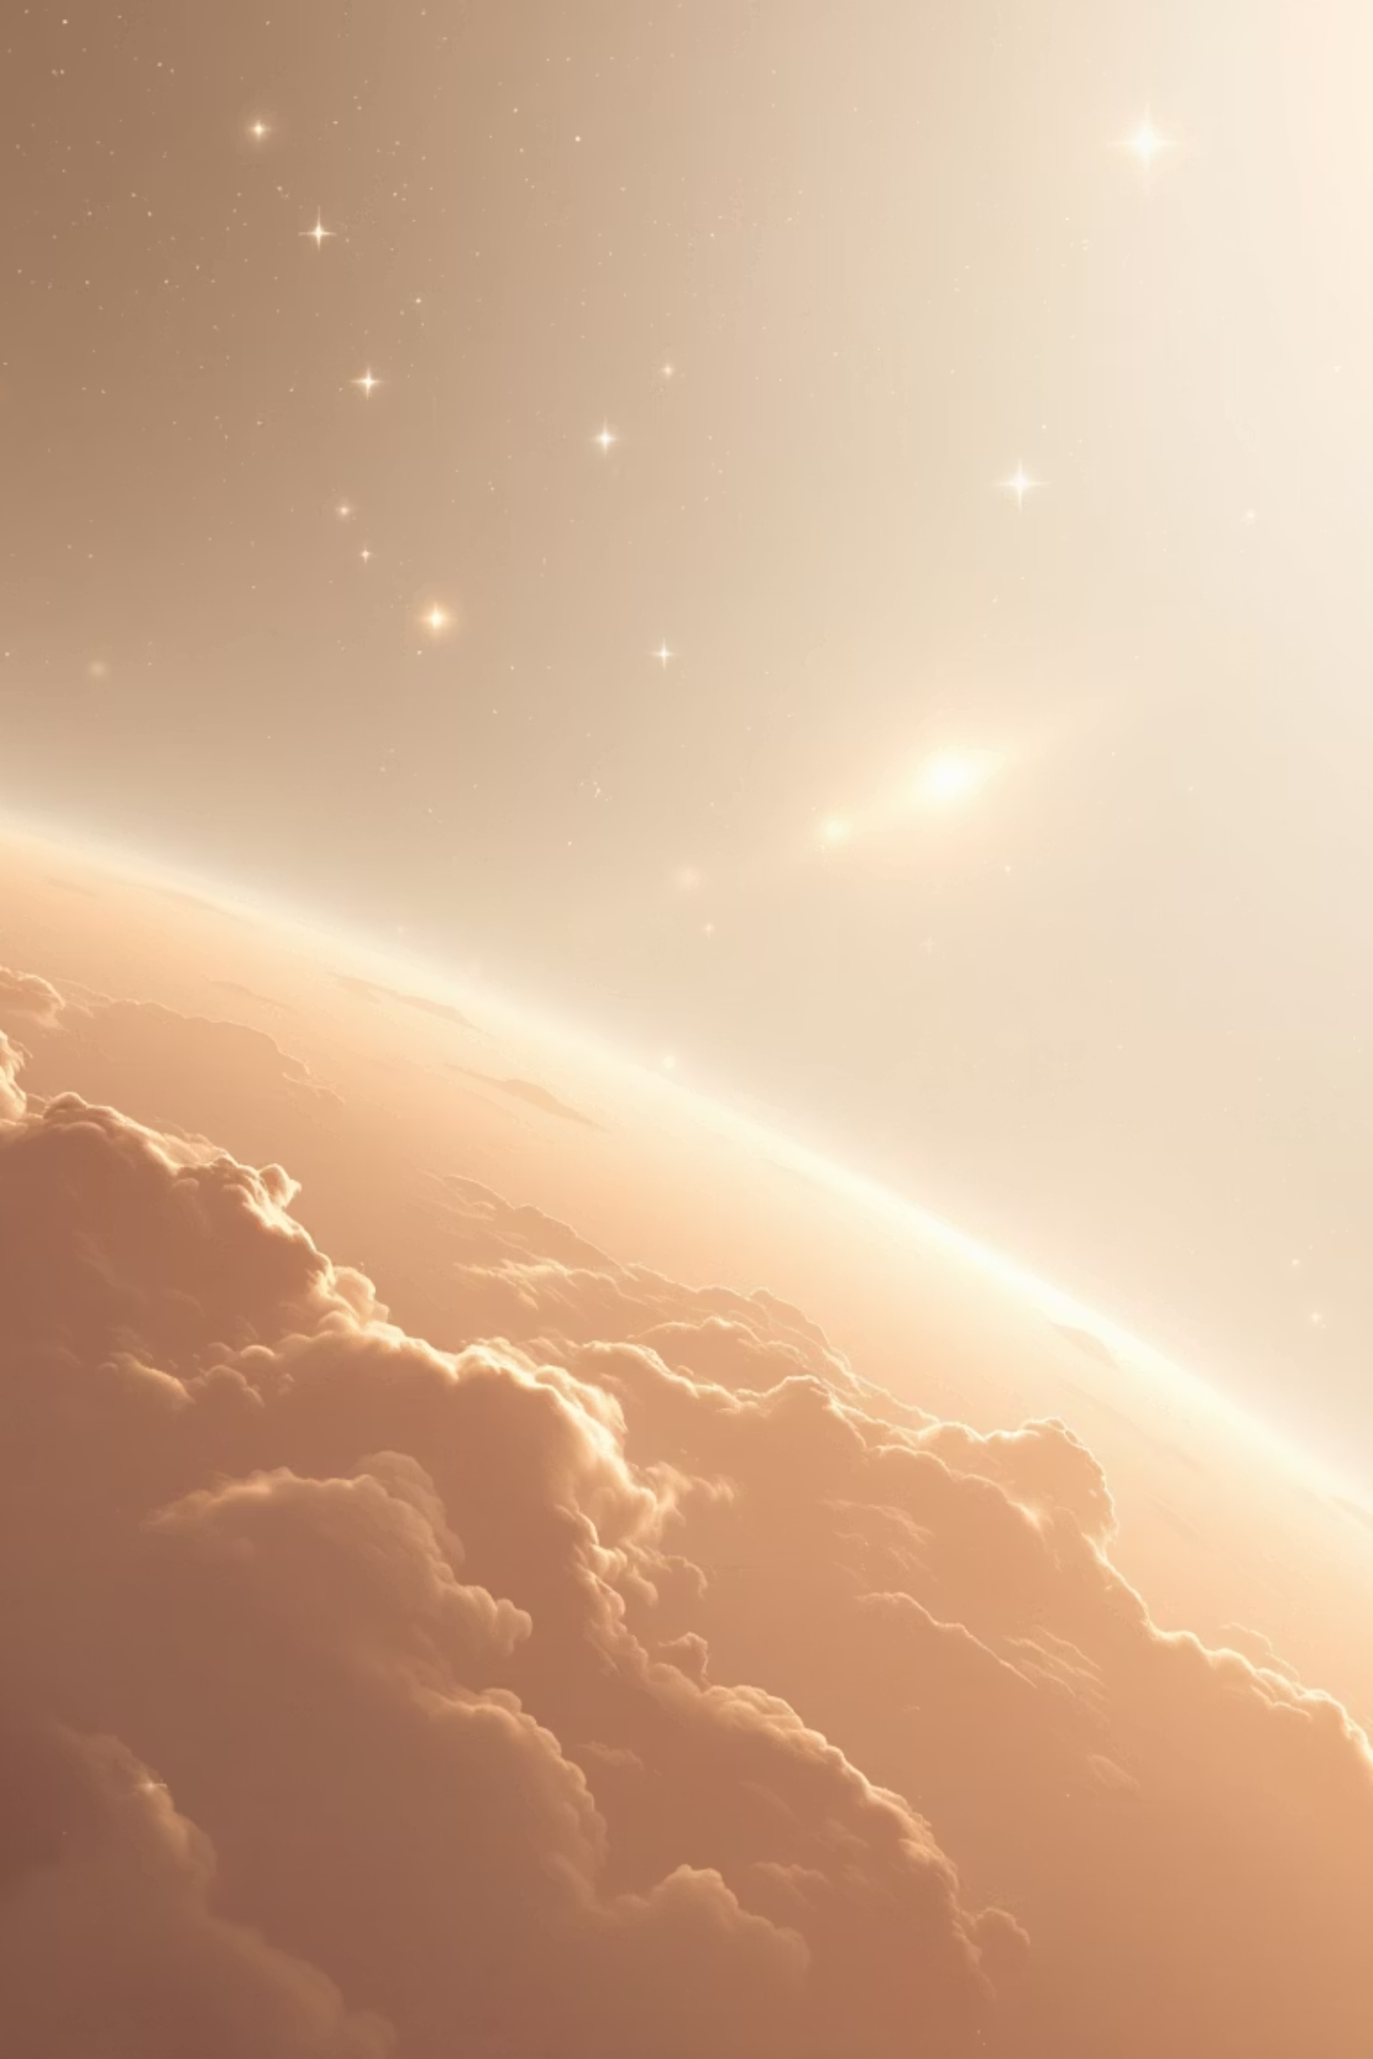
NASA: Exploring the Final Frontier
Discover the wonders of space exploration through NASA's groundbreaking journey, pushing the boundaries of human achievement and scientific discovery since its inception.

Slide 2

NASA’s Mission & Vision
Driving Scientific Advances
Leading Exploration Efforts
NASA pioneers breakthroughs in science, technology, and exploration to benefit all humanity, fostering innovation that transforms our understanding of the universe and improves life on Earth.
Since 1958, NASA has spearheaded space exploration, Earth science research, and aeronautics innovation, from orbiting satellites to probing distant worlds.

Slide 3
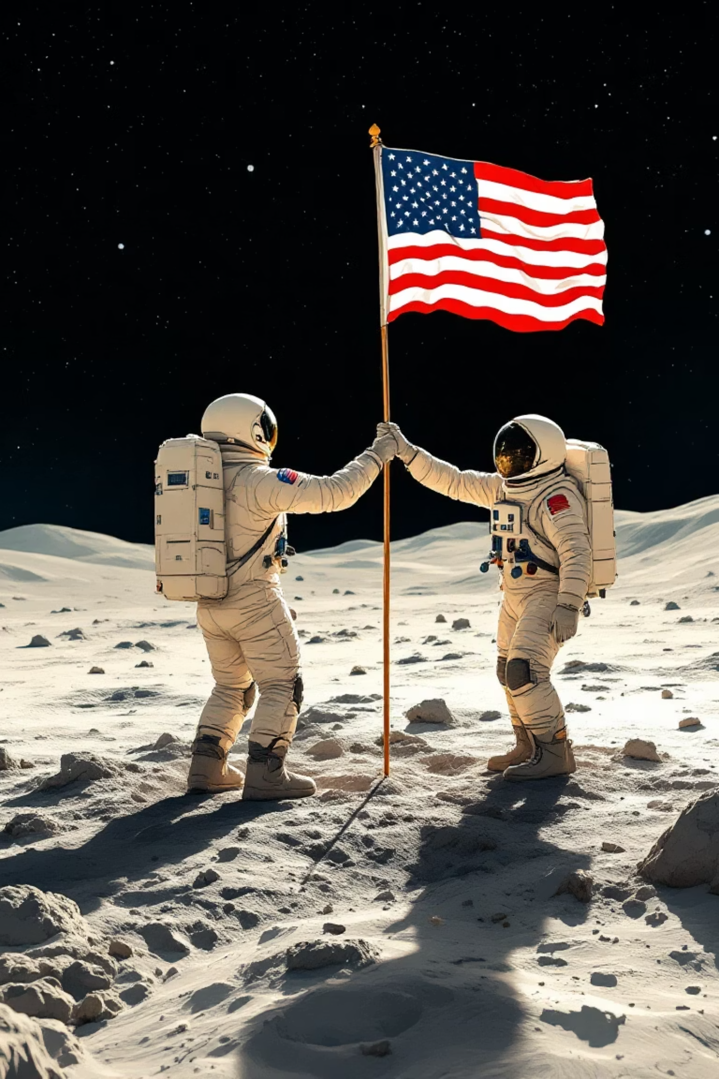
Iconic NASA Programs
1
Apollo Moon Landings (1969)
The historic achievement of the first humans on the Moon during Apollo 11, marking a giant leap for mankind and advancing lunar exploration technology.
2
Mars Rovers: Curiosity & Perseverance
Robotic explorers traversing the Martian terrain, analyzing rocks, atmosphere, and potential signs of ancient life to unravel the Red Planet's mysteries.
3
Hubble Space Telescope (30+ Years)
Orbiting observatory capturing breathtaking images of distant galaxies, nebulae, and black holes, revolutionizing astronomy and our cosmic perspective.

Slide 4
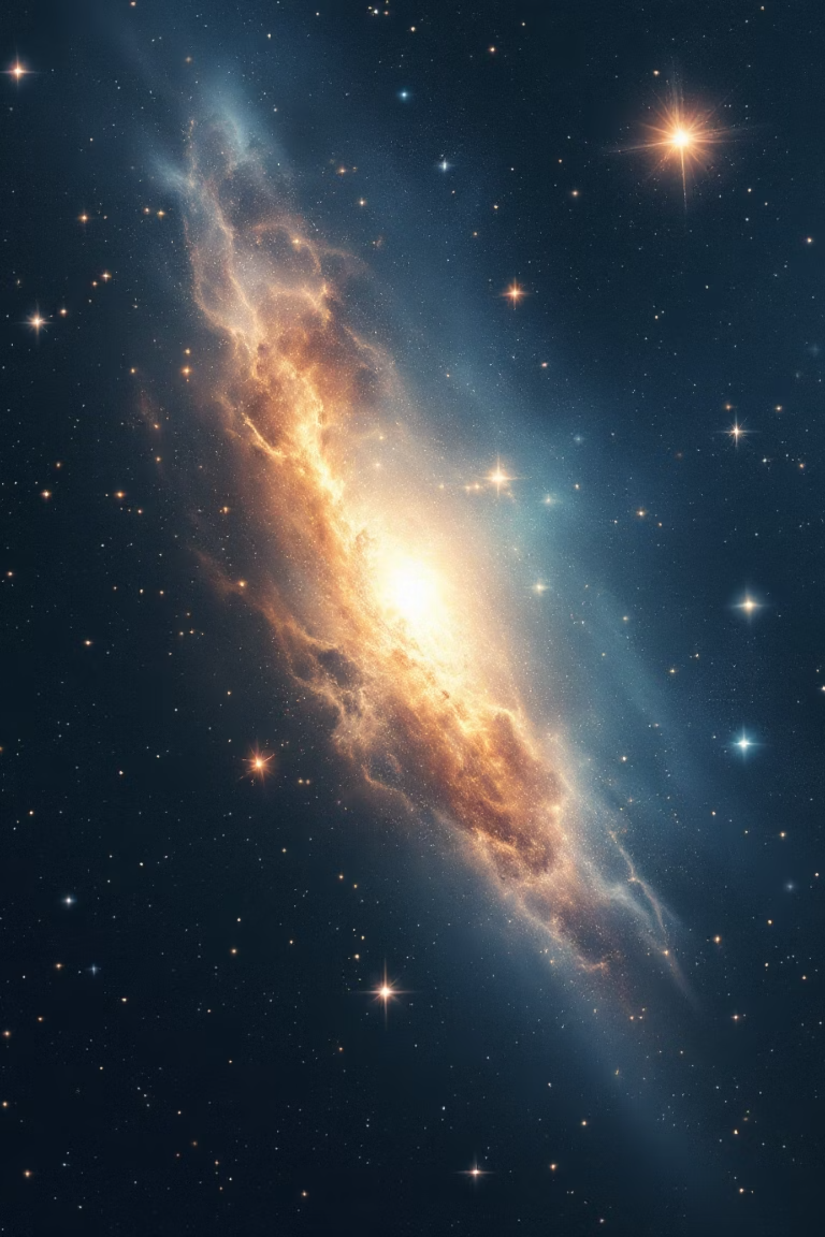
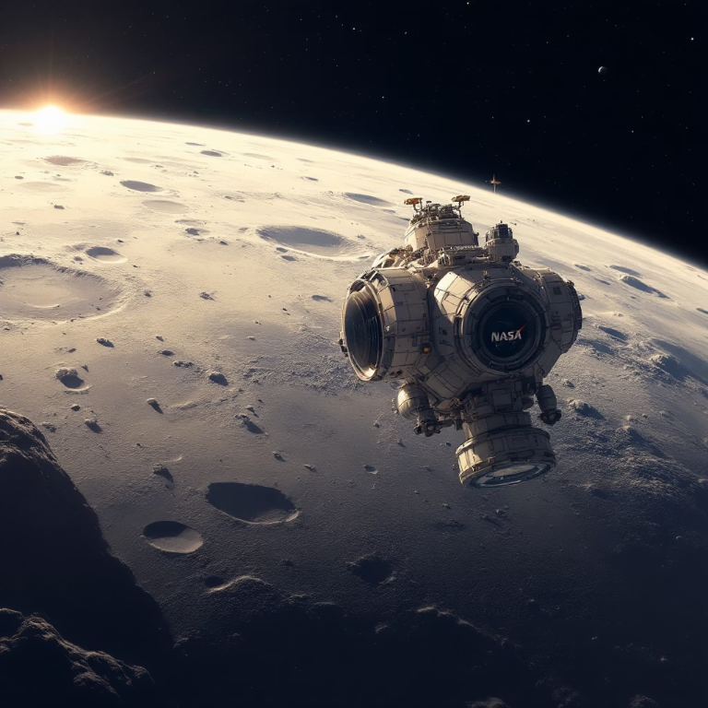
Recent Breakthroughs & Discoveries
01
Artemis I (2022)
Uncrewed test flight successfully orbited the Moon, validating systems for NASA's planned human return by 2026, including sustainable lunar presence.
02
James Webb Space Telescope (2021 Launch)
Peering into the universe's infancy, it reveals the earliest galaxies, exoplanet atmospheres, and cosmic phenomena never seen before.
03
Mars Sample Return Mission
Ambitious collaboration to retrieve and return Martian soil samples to Earth, potentially confirming evidence of past microbial life.

Slide 5
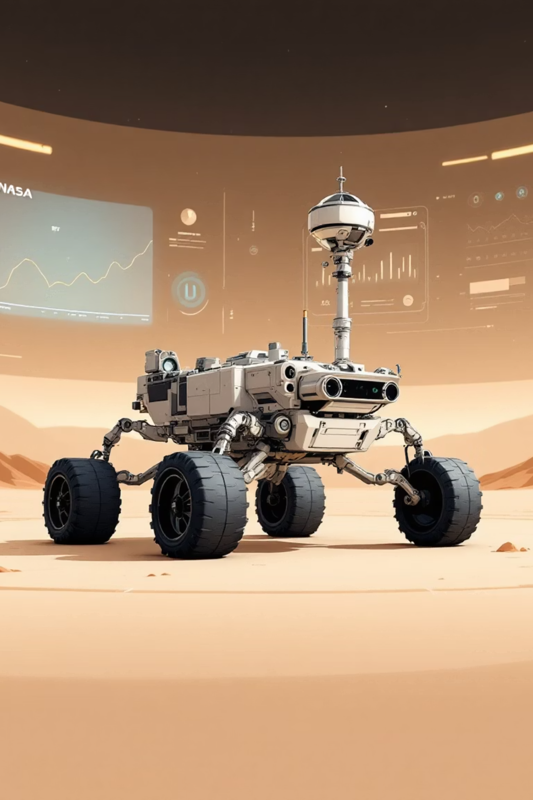



NASA’s Fleet of Spacecraft
Over 20 Active Missions
A diverse array of probes and satellites studying planets, stars, asteroids, and Earth's changing climate, providing invaluable data for global challenges.
Solar Dynamics Observatory
Continuously monitors the Sun's dynamic atmosphere in real-time, tracking solar flares and coronal mass ejections that impact space weather and Earth.
Perseverance Rover
Navigating Jezero Crater on Mars, collecting rock samples, testing oxygen production, and hunting for biosignatures of ancient life forms.

Slide 6
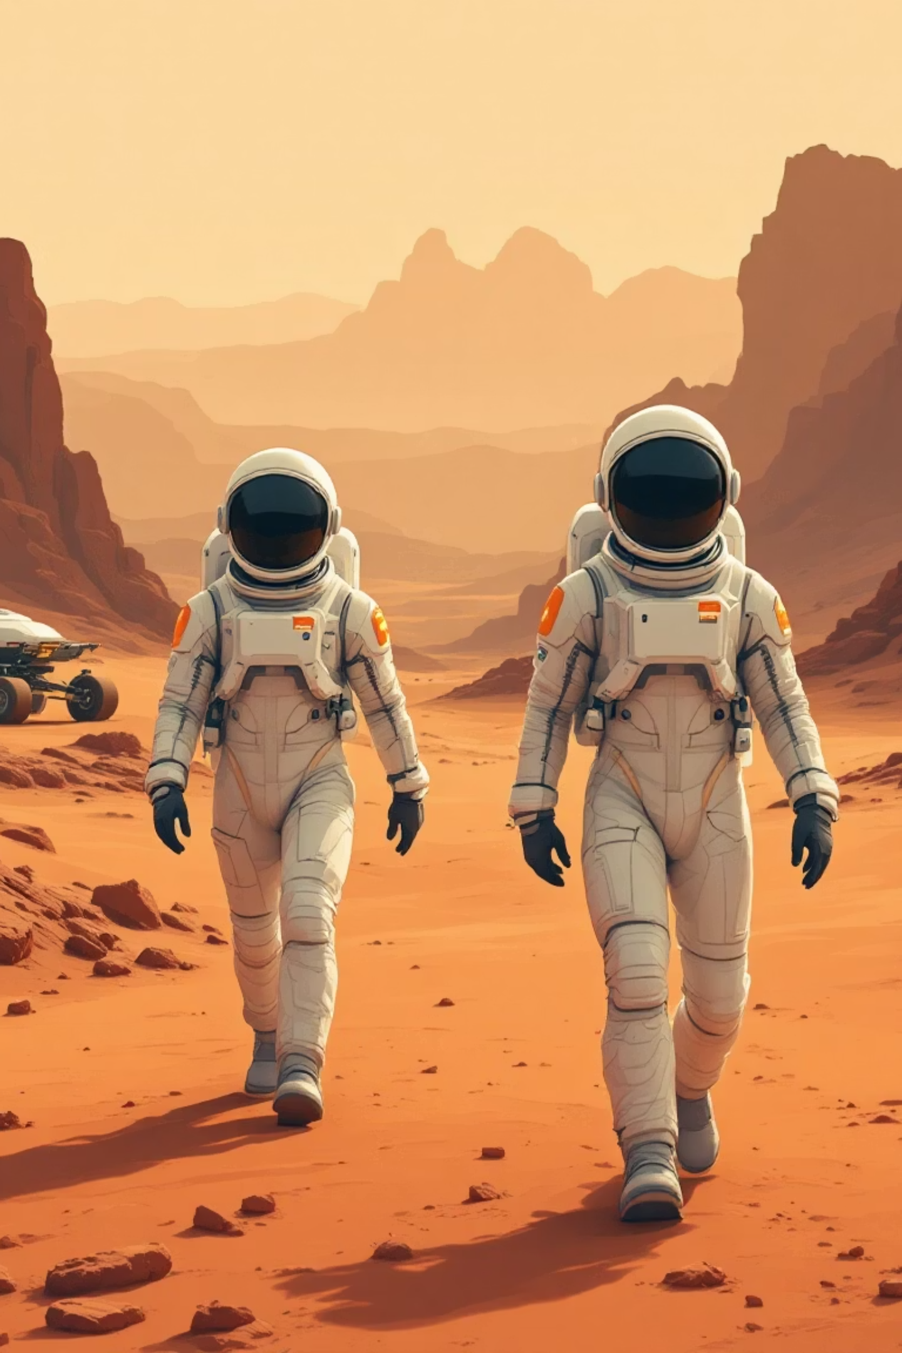



The Future of NASA Exploration
Human Missions to Mars (2030s)
Ambitious plans for crewed voyages to the Red Planet, building on Artemis to establish human footholds and conduct in-depth scientific research.
International Partnerships
Collaborating with global space agencies and expanding commercial spaceflight to share resources, expertise, and accelerate multi-planetary ambitions.
Advanced Technologies
Developing next-generation propulsion systems, AI-driven autonomy, and sustainable habitats to enable deeper space travel beyond our solar system.
Reaching New Horizons

Slide 7


Join NASA’s Journey
Inspiring the Next Generation
Stay connected: Visit nasa.gov for live mission streams, interactive educational tools, citizen science opportunities, and ways to contribute to humanity's space odyssey.
From students to seasoned experts, NASA fuels curiosity in explorers, scientists, and engineers, shaping tomorrow's innovators through education and outreach programs.
Together, we push boundaries, unlock cosmic secrets, and dream of the stars—your participation makes it possible.
Reach for the stars with NASA today!

